Slide 1
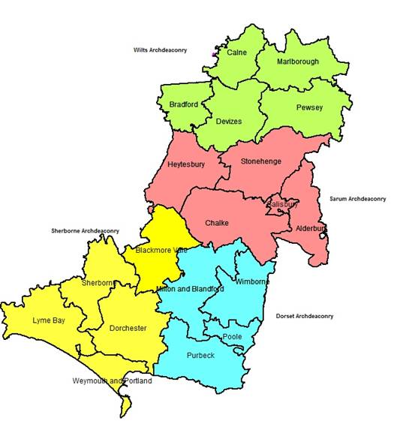
2023 DAC AWARDS
Presented by
The Rt Revd Andrew Rumsey, Bishop of Ramsbury

Slide 2
Innovation Award

Slide 3
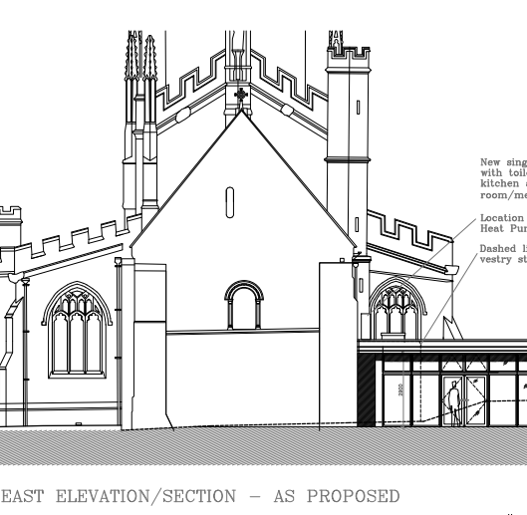
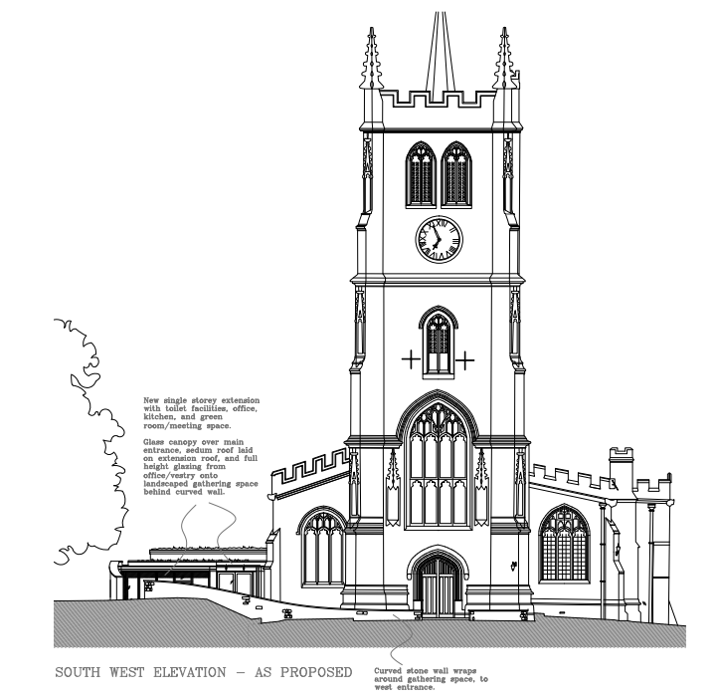
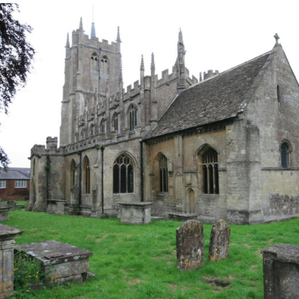
Innovation Award – Winner
Devizes, St Mary –
Single storey extension & re-ordering

Slide 4
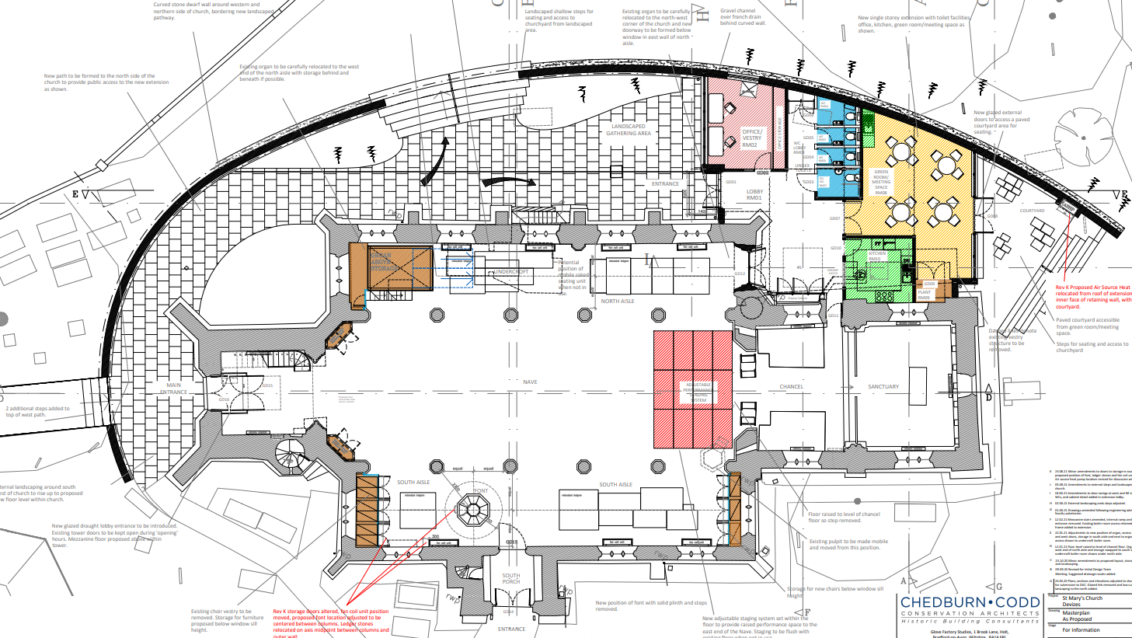

Slide 5
Environment Award

Slide 6
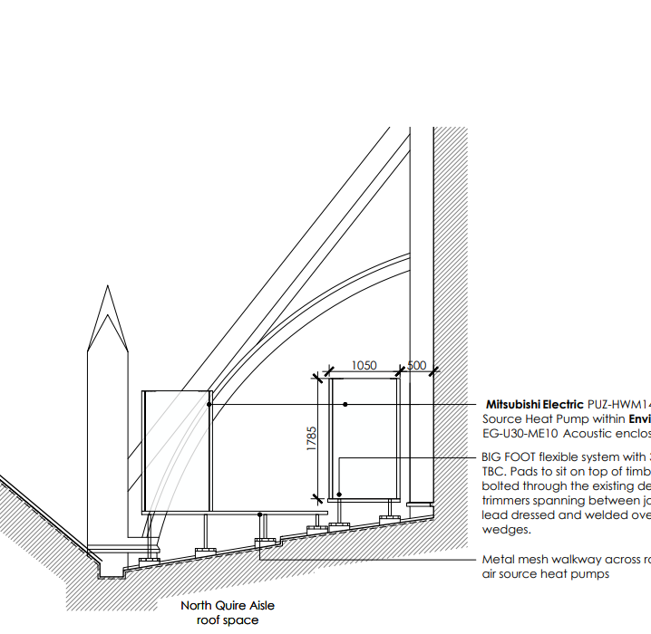
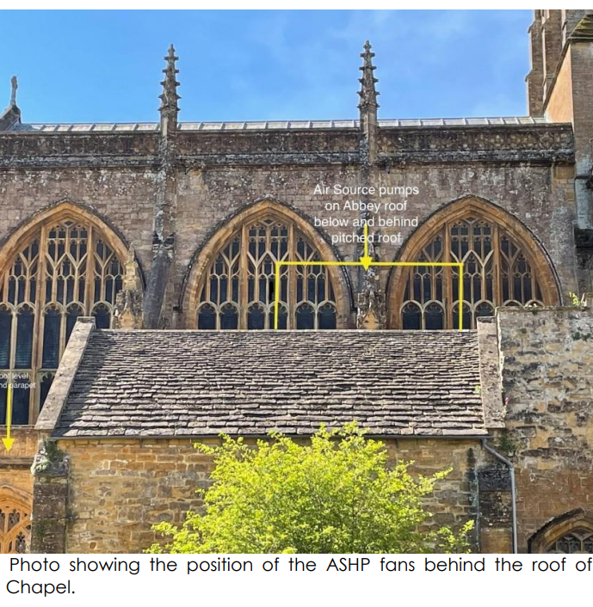
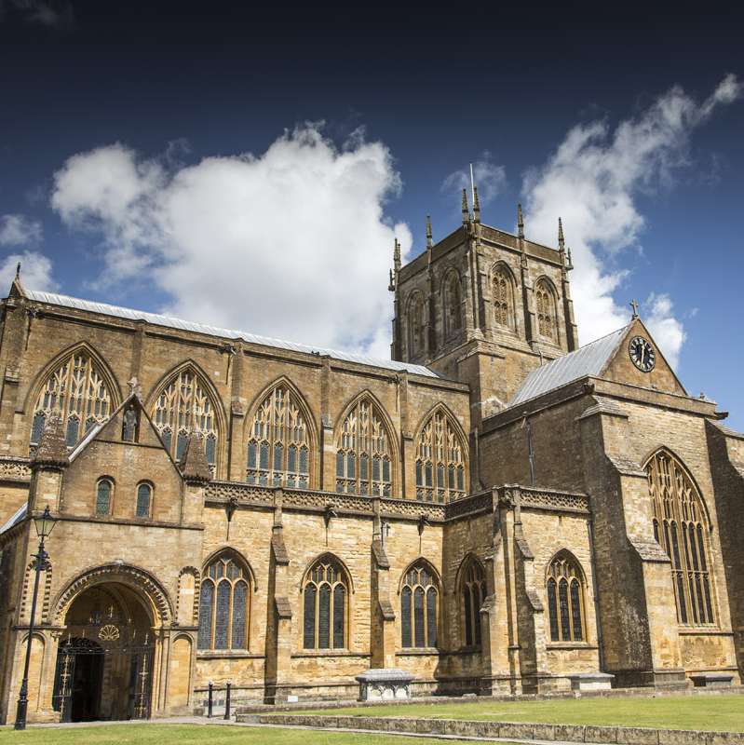
Environment Award – Runner Up
Sherborne, Abbey Church of St Mary –
Replacement of gas boiler with air source heat pump

Slide 7
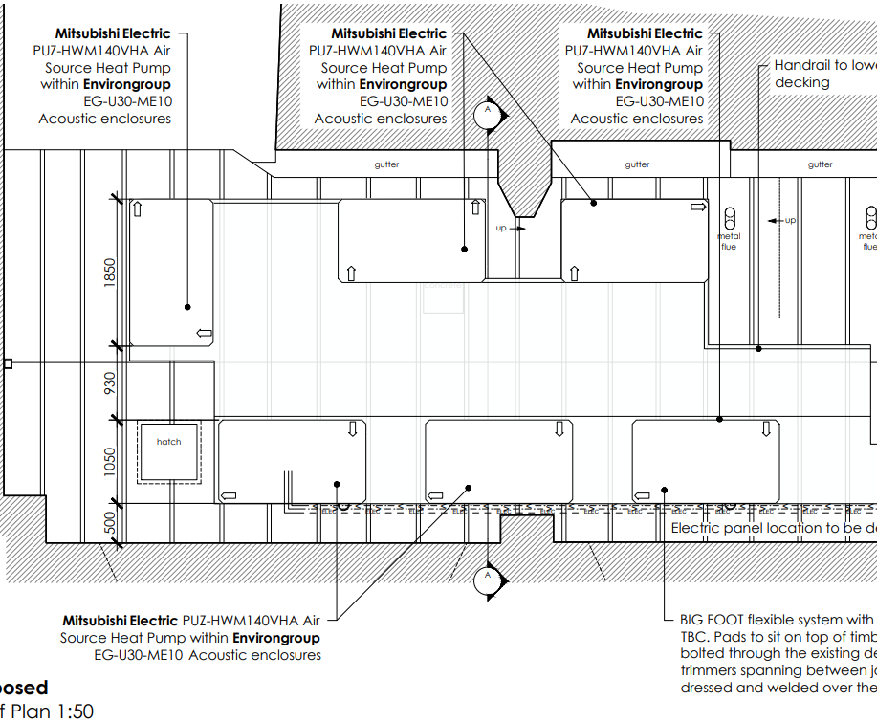
Environment Award –
Runner Up
Sherborne, Abbey Church of St Mary – Replacement of gas boiler with air source heat pump

Slide 8
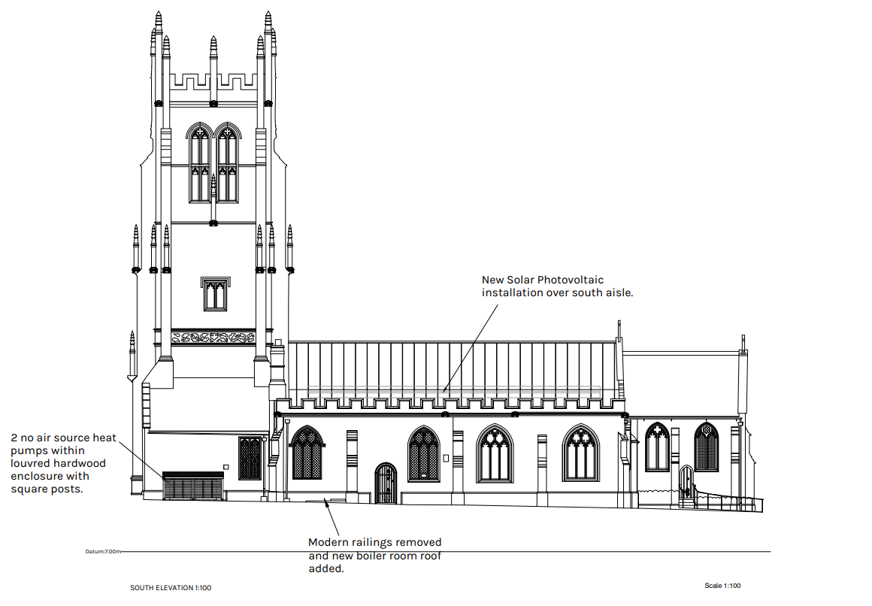
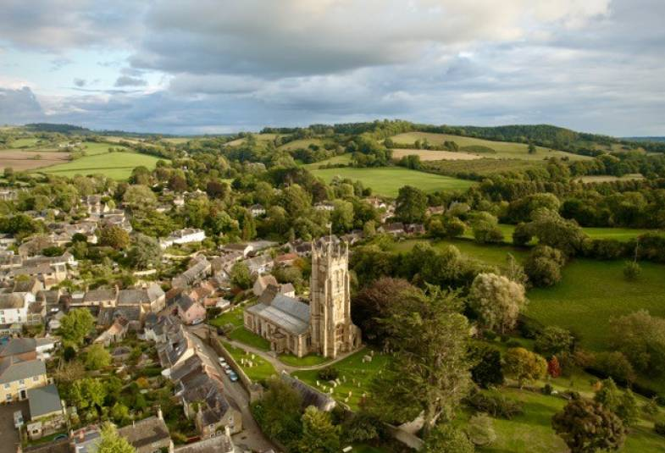
Environment Award – Winner
Beaminster, St Mary –
Installation of solar panels & air source heat pump

Slide 9
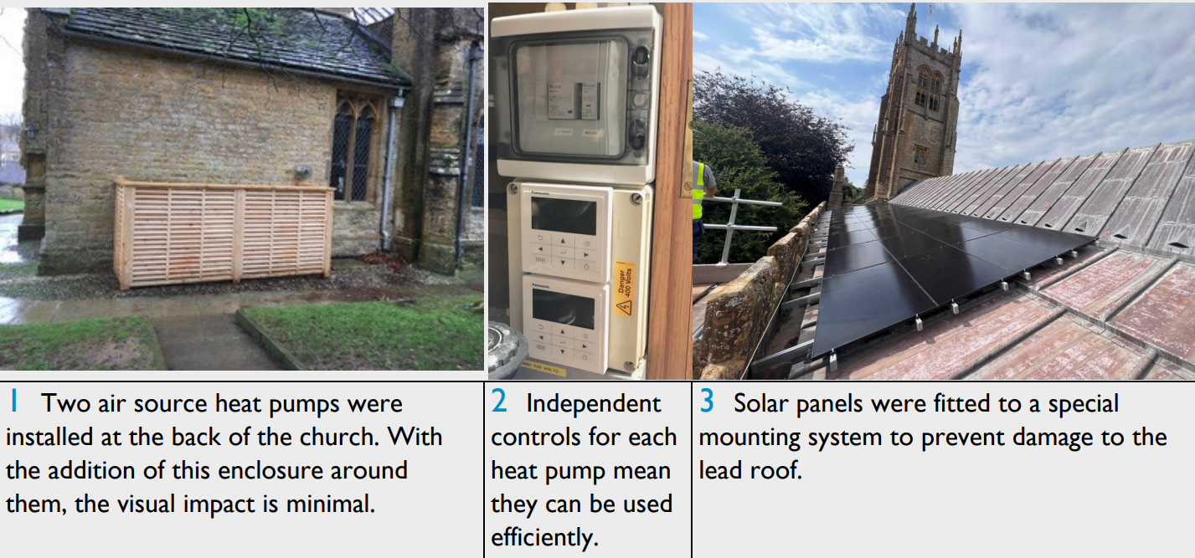
Environment Award – Winner
Beaminster, St Mary –
Installation of solar panels & air source heat pump

Slide 10
Conservation Award

Slide 11
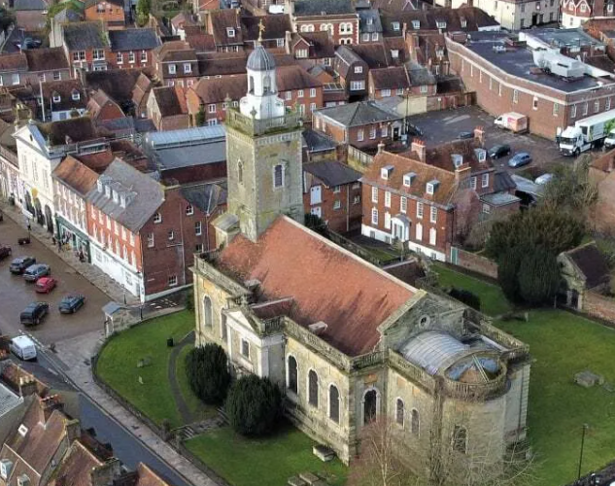
Conservation Award – Runner Up
Blandford Forum, St Peter & St Paul – Repairs to high level masonry, internal plasterwork & insulation

Slide 12
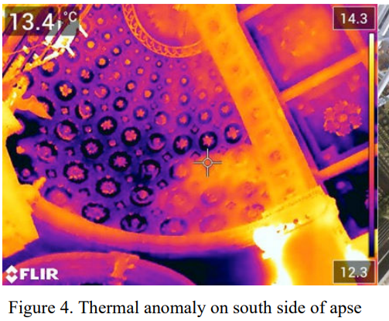
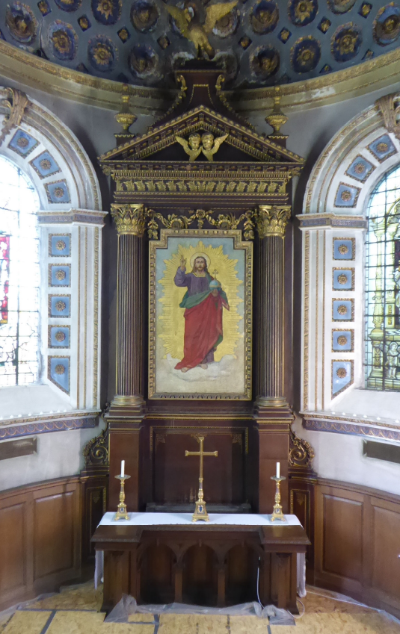
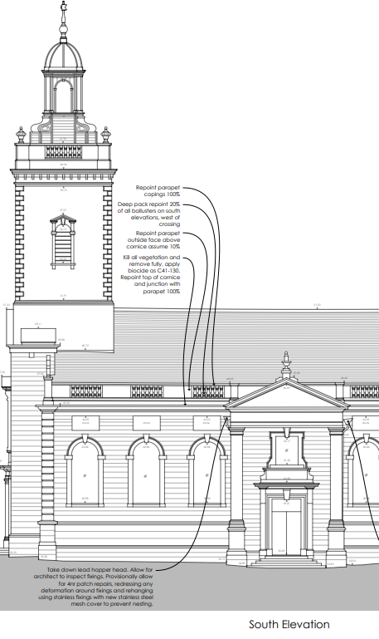
Conservation Award – Runner Up
Blandford Forum, St Peter & St Paul – Repairs to high level masonry, internal plasterwork & insulation

Slide 13
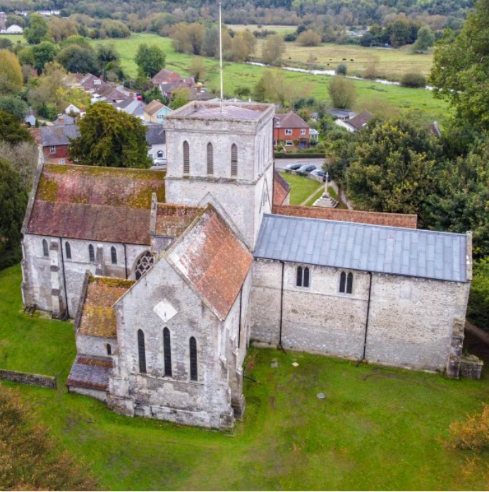
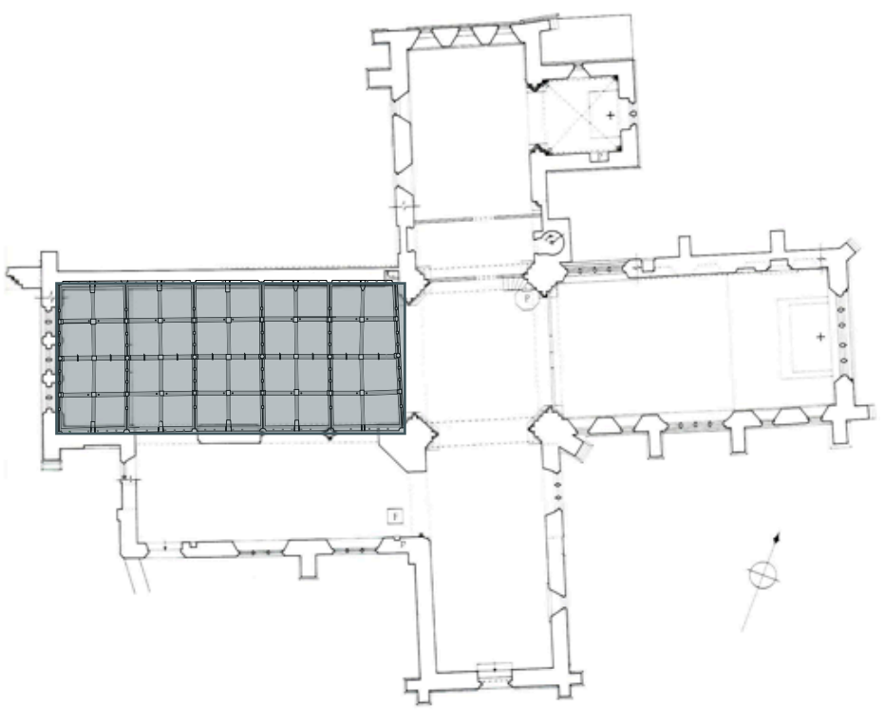
Conservation Award – Winner
Amesbury, St Mary & St Melor – New oak carvings within nave roof

Slide 14
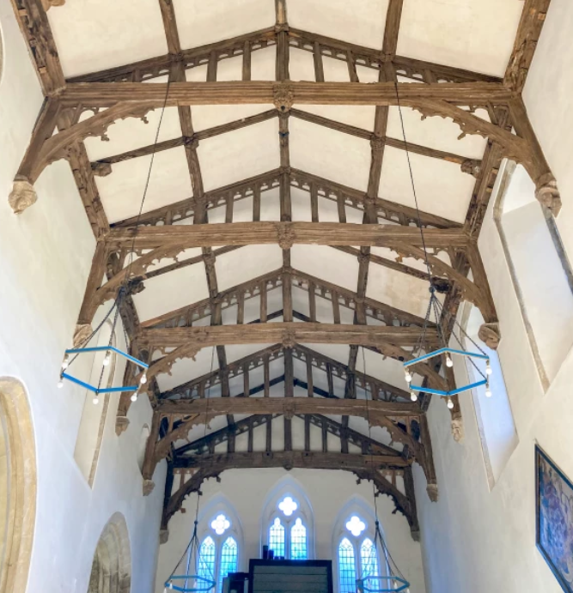
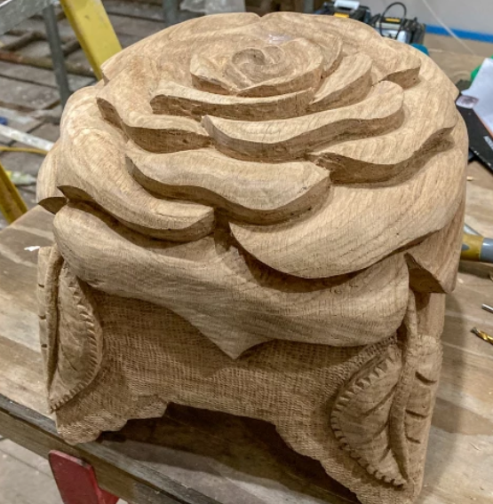
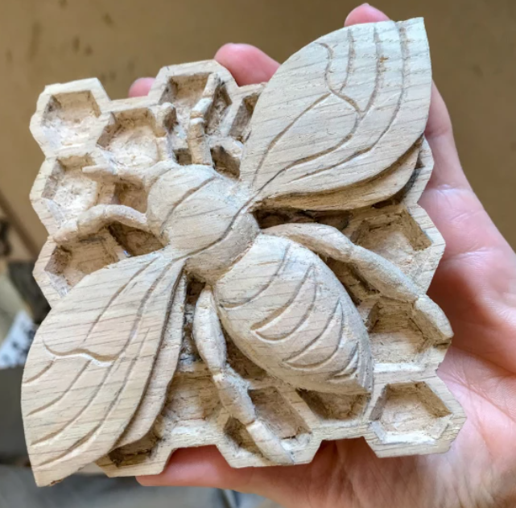
Conservation Award – Winner
Amesbury, St Mary & St Melor –
New oak carvings within nave roof

