Slide 1
Making Jesus Known Engagement Questions
Photo: Neil Turner/Lambeth

Slide 3
Opening prayer
Gracious God,​
We thank you for calling us ​
into the fellowship of your Son.​
Empower us by your Spirit​
to seek your Kingdom, ​
here and now,
that we might Make Jesus Known
in every place.
For your name's sake,
Amen

Slide 4
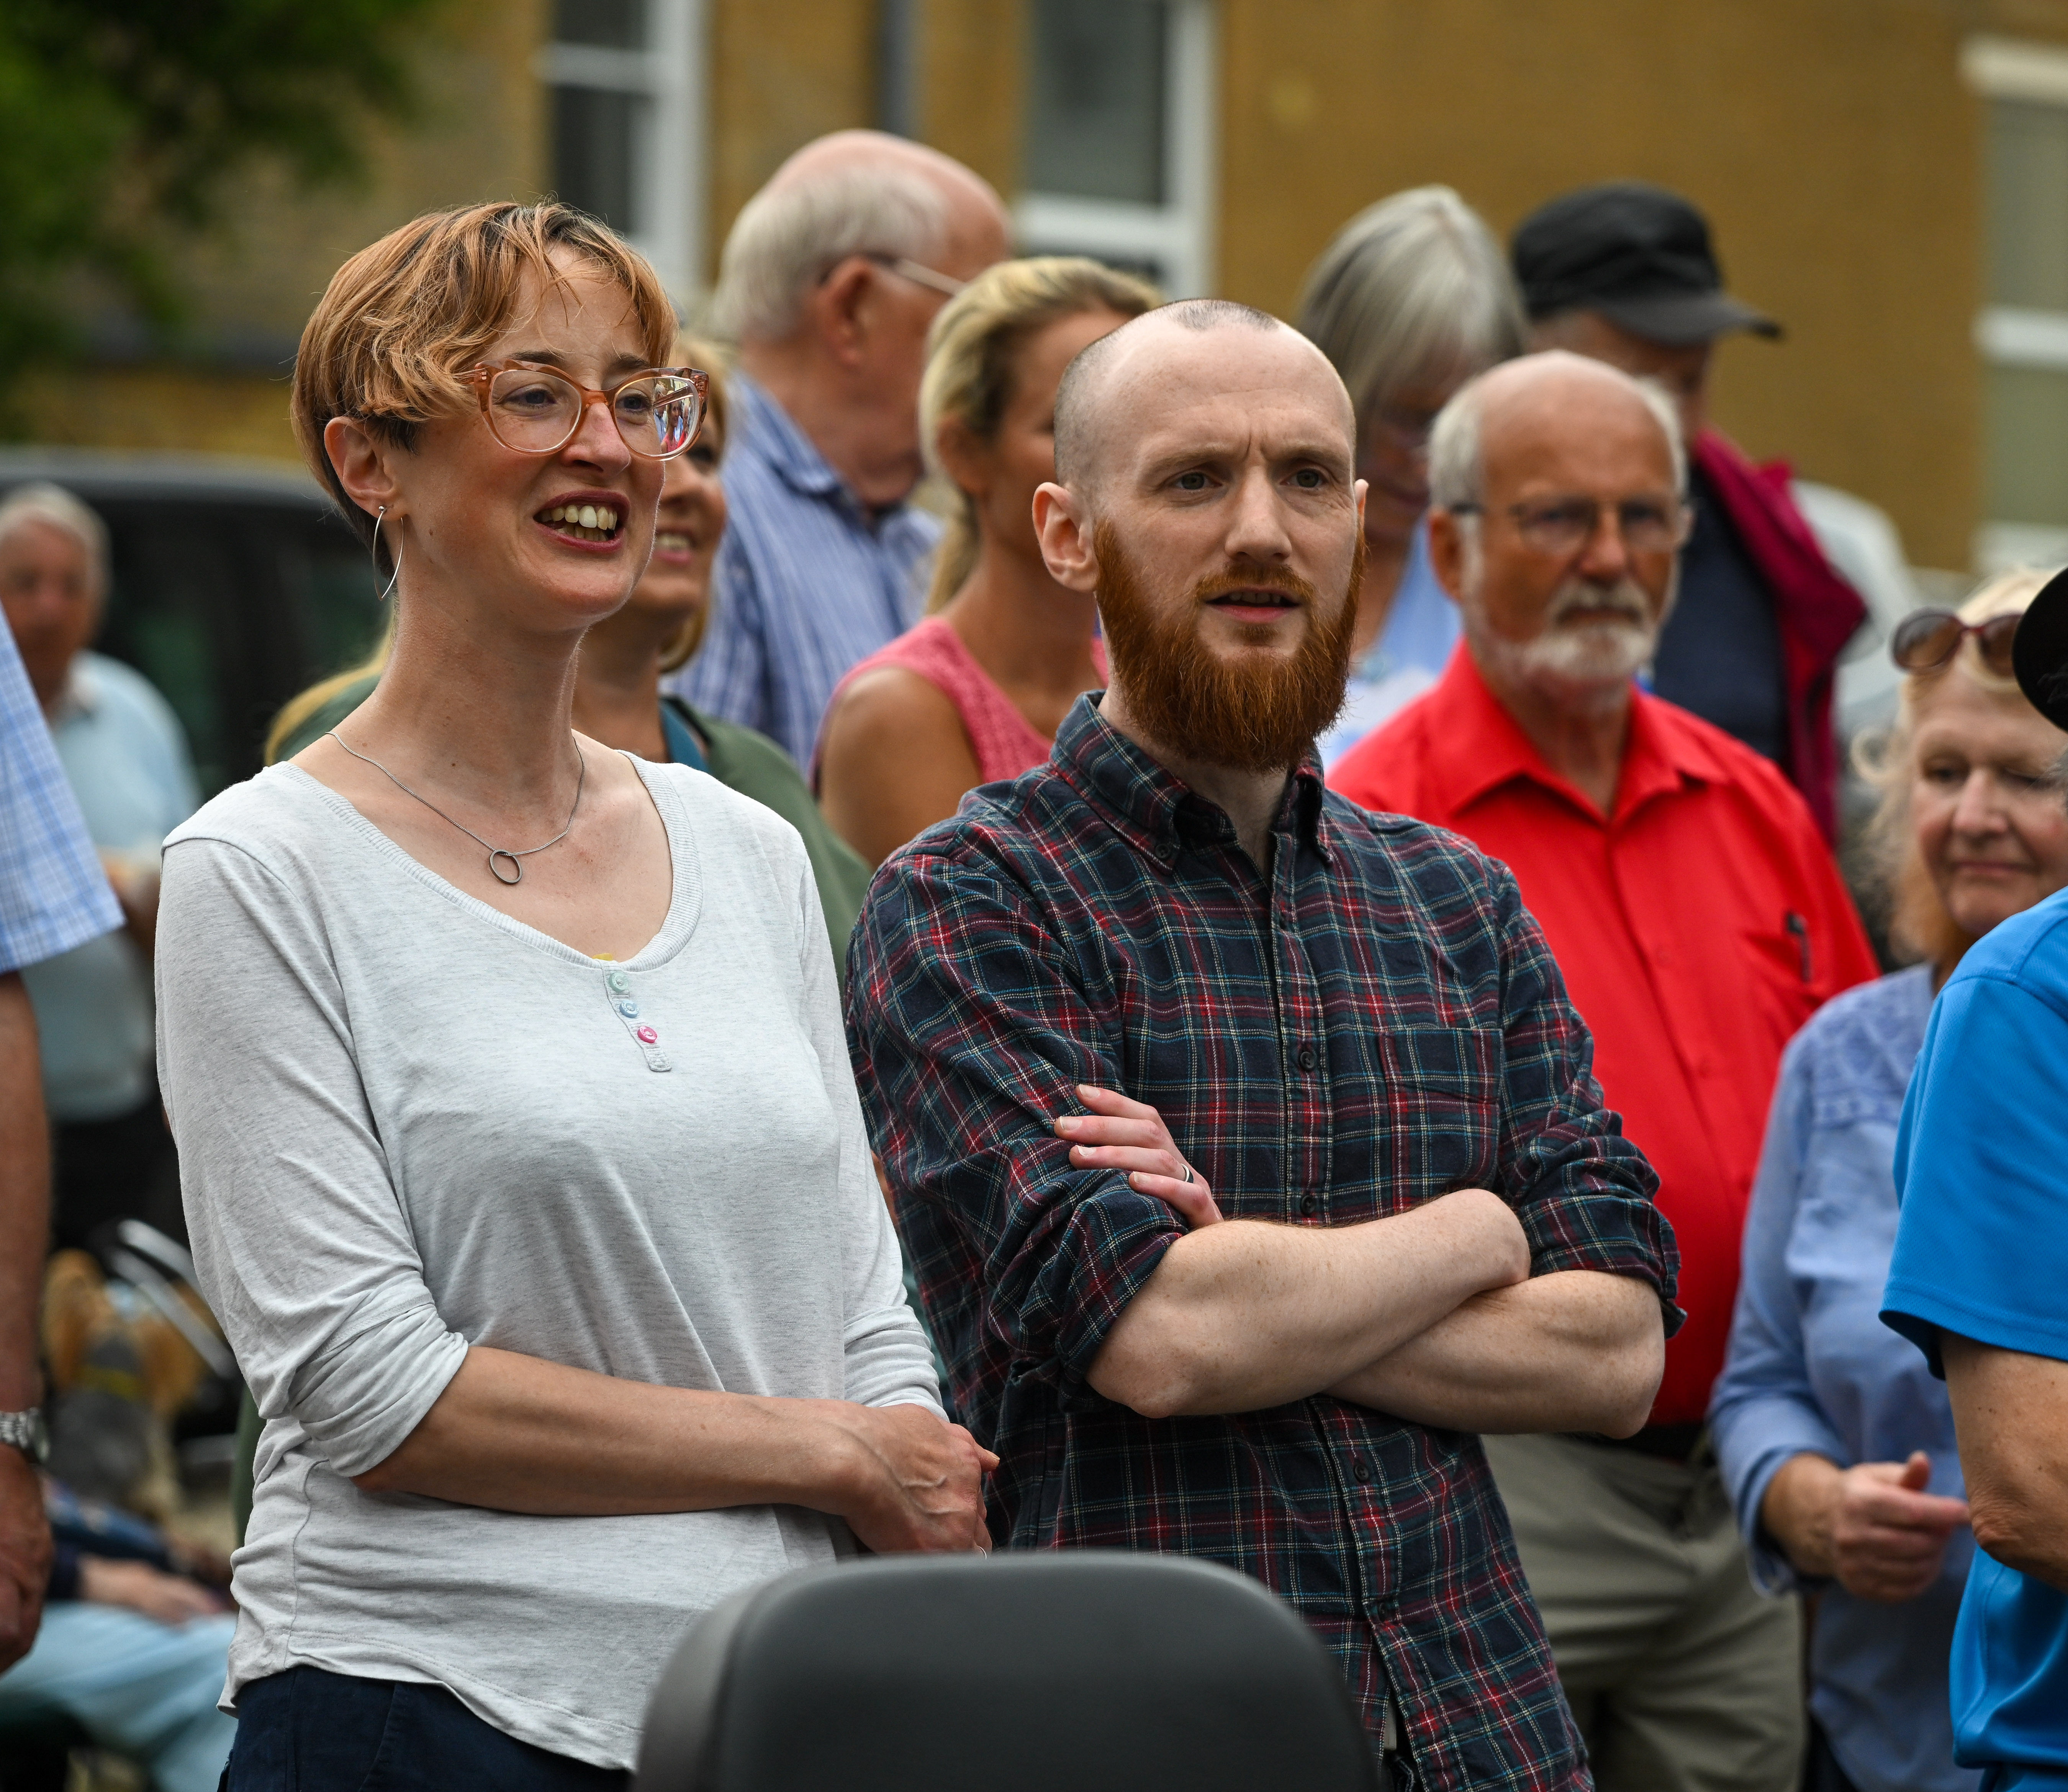
Question
one
Where you are already engaged in aspects of the vision and priorities, what’s working well? What outcomes are you pleased to see?
Photo: Finbarr Webster/Diocese of Salisbury

Slide 5
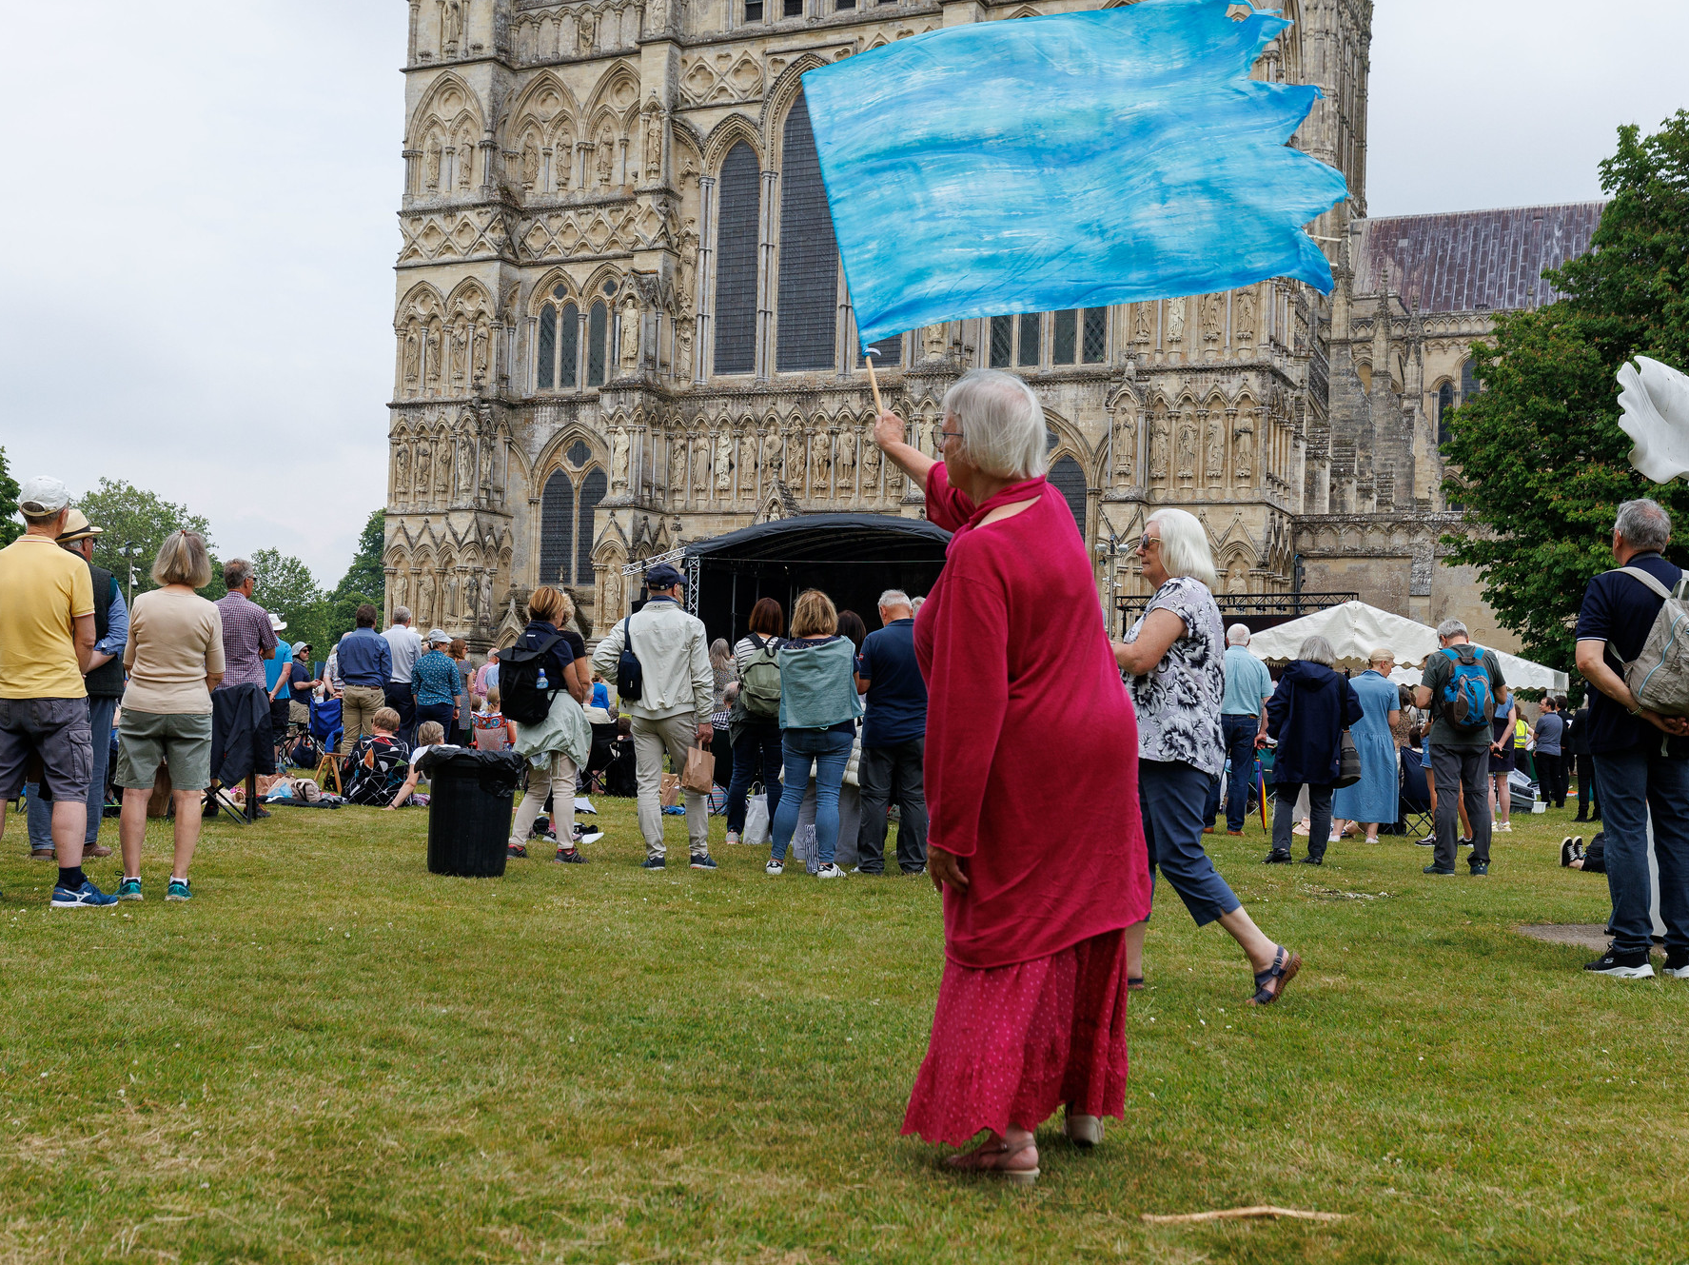
Question
two
What further opportunities does the vision statement Making Jesus Known suggest or open up in your parish or place?
Photo: Neil Turner/Lambeth

Slide 6
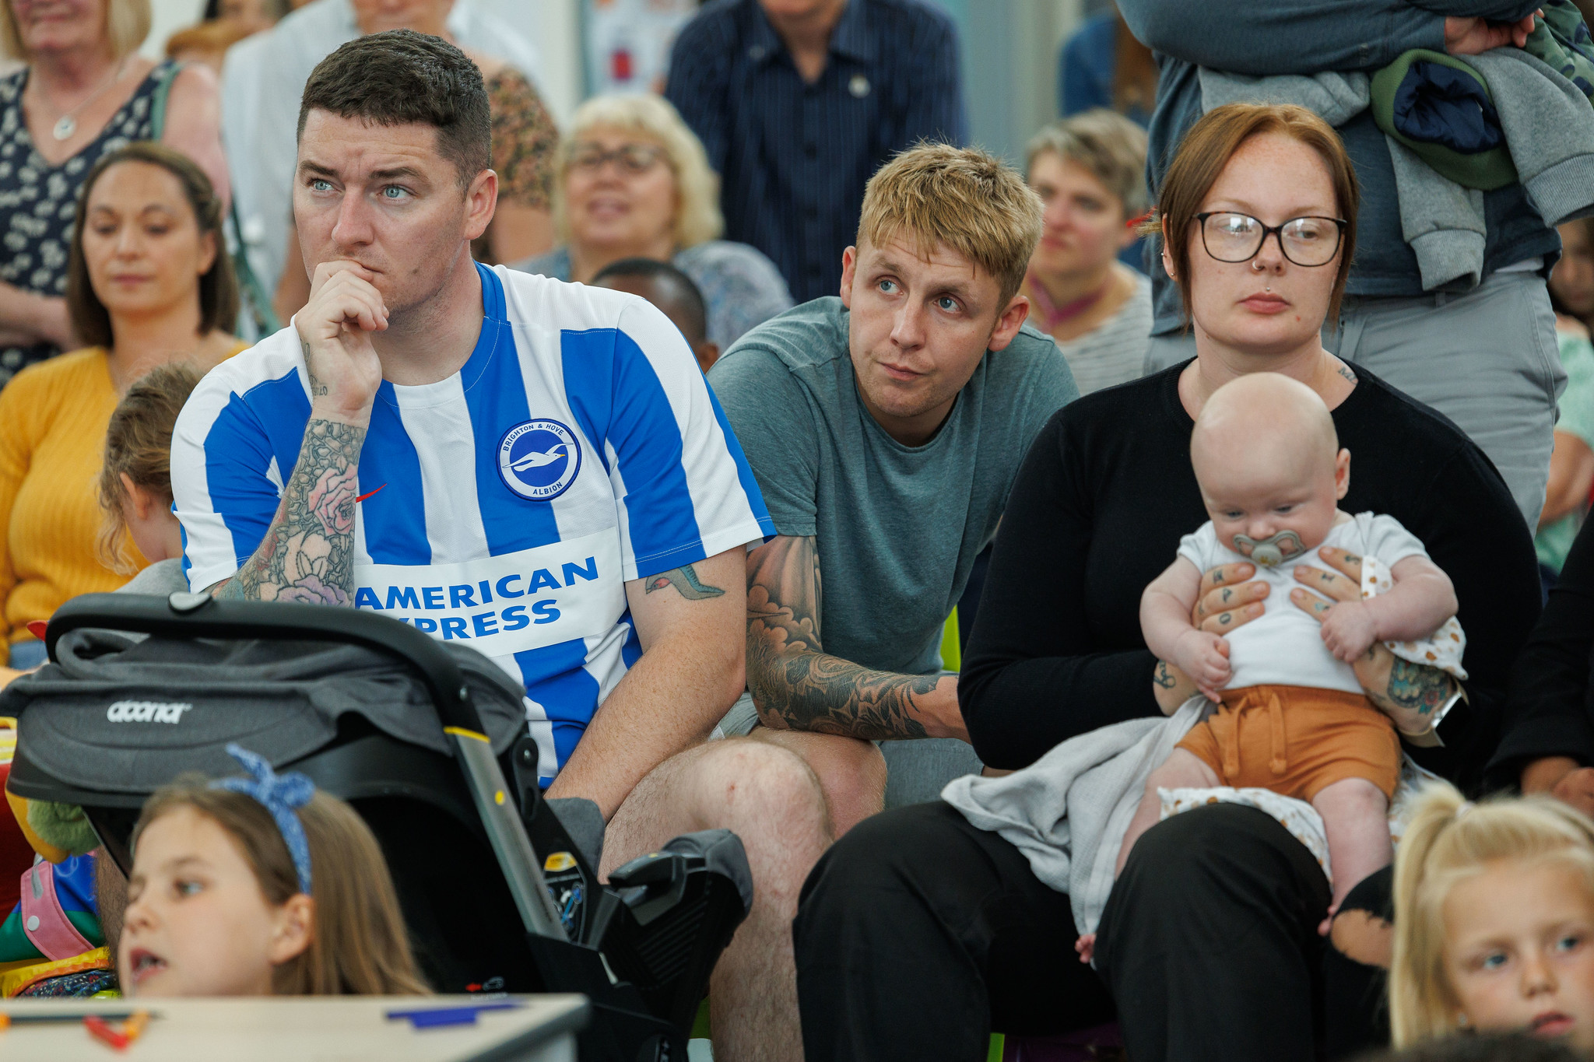
Question
three
What would you like to explore further?
What support might you need?
Photo: Neil Turner/Lambeth

