Slide 1
Diocesan Synod
Onboarding
September 2024

Slide 2
Diocesan Synod

Slide 3
Synodical Structures
General Synod
INFORMATION & OPINIONS
Diocesan Synod
ARTICLE 8 BUSINESS
Deanery Synod
RAISING MATTERS FOR DISCUSSION
PCC
Notes:
INFORMATION AND OPINIONS: see s.4(5) Synodical Government Measure 1969:
(5) The diocesan synod shall keep the deanery synods of the diocese informed of the policies and problems of the diocese and of the business which is to come before meetings of the diocesan synod, and may delegate executive functions to deanery synods; and shall keep themselves informed, through the deanery synods, of events and opinion in the parishes, and shall give opportunities for discussing at meetings of the diocesan synod matters raised by deanery synods and parochial church councils.
Also s.5 (3): duty of Deanery Synod to consider business of Diocesan Synod, sound parochial opinion, raise matters with Diocesan Synod.
ARTICLE 8 BUSINESS: Permanent changes to key services (baptism, holy communion, ordinal) or union with other Christian bodies etc requires approval of majority of Diocesan Synods, and 2/3 majority in General Synod Houses. Diocesan Synods sometimes refer to Deanery Synods for an opinion too (but aren’t required to.)
RAISING MATTERS FOR DISCUSSION: See s.2(2)(e) Parochial Church Councils (Powers) Measure 1956; s.5(3)(e) and 4(2)(c) Synodical Government Measure 1969

Slide 4
Company Structures
The Diocesan Board of Finance (DBF) is:
a private company limited by guarantee without share capital, registered with Companies House
A charity, registered with the Charity Commission
Its objects are to support the purposes of the Church of England in the Diocese, particularly by
Holding property, funds and assets
Resourcing ministry (stipends, housing, resources)
The Company
Members are the “owners” but don’t run the company
Members entrust the running of the company to the Directors
Diocesan Synod
Bishop’s Council = Directors
= Members

Slide 5
Diocesan Synod
Constitution (outline)
House of Bishops
Diocesan Bishop (President)
Suffragan Bishops
House of Clergy
The Dean of Salisbury
Archdeacons & Deans of the Channel Islands
Clergy on General Synod
Clergy elected by Deanery Synods
Co-opted clergy
Clergy nominated by the bishop
House of Laity
Laity on General Synod
Laity elected by Deanery Synods
Co-opted laity
Laity nominated by the bishop
Notes:
Standing Orders of Salisbury Diocesan Synod

Slide 6
Diocesan Synod
Functions
Consultative & Advisory
Consider matters concerning the Church of England and make provision for them in the Diocese
Express opinions on matters of religious or public interest
(But not on issues of doctrine)
Advise the bishop on matters on which he consults the Synod
Bishop has duty to consult Synod on matters of general concern and importance in the diocese
Notes:
See section 4(2) Synodical Government Measure 1969

Slide 7
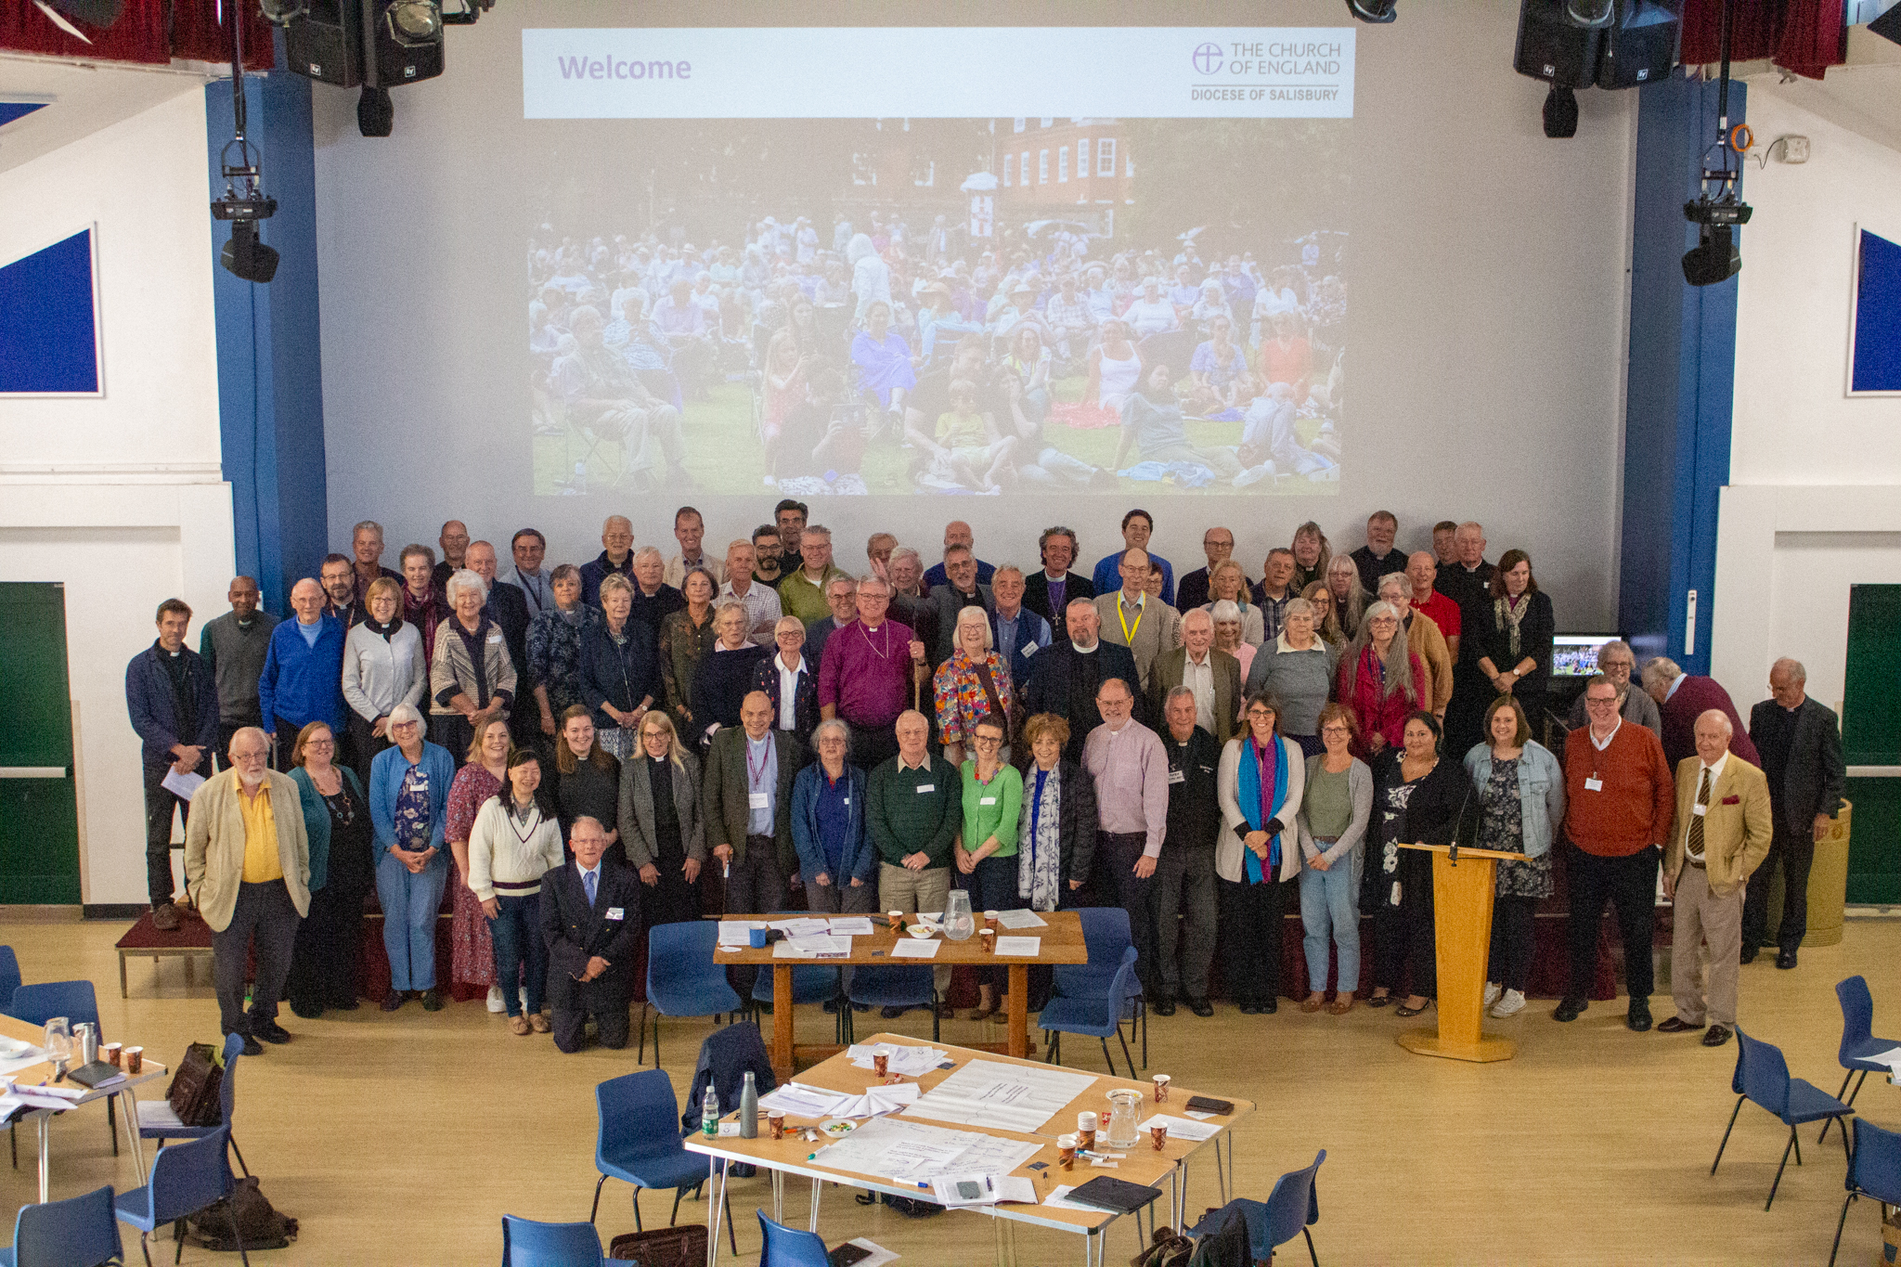
Diocesan Synod
Functions
Financial
Consider annual accounts of the DBF
Approve the annual budget of the DBF
Notes:
See section 4(2) Synodical Government Measure 1969

Slide 8
Diocesan Synod
Functions
Governance: Synod
Elect (by Houses):
Vice President / Chair of Clergy
Vice President / Chair of Laity
Co-opt (by Houses) additional members of Diocesan Synod (may be nominated by Bishop’s Council)
Notes:
See Standing Orders of Salisbury Diocesan Synod

Slide 9
Diocesan Synod
Functions
Governance: Company (DBF)
Elect:
Chair of the DBF
Vice Chair of the DBF
Appoint the Auditors
Consent to variations in the DBF Articles of Association
Notes:
See Article 12 (elections) and Article 57 (varying Articles) of the DBF Articles of Association
Apoint Auditor – see Article 9 of the Salisbury DBF Articles of Association

Slide 10
Diocesan Synod
Functions
Miscellaneous
Various statutory provisions, eg
Diocesan Bishop must consult Diocesan Synod before making an instrument of delegation to another bishop (unless urgent)
Provide or vary terms of reference for various diocesan bodies, eg Diocesan Mission and Pastoral Committee, Diocesan Parsonages Board
Notes:
Dioceses, Pastoral and Mission Measure 2007
Mission and Pastoral Measure 2011
Repair of Benefice Buildings Measure 1972

Slide 11
Diocesan Synod
Procedures
Meetings
Convened by the President (the bishop)
or on request of Bishop’s Council
or on request of 30 members
At least 2 meetings each year
6 weeks notice
In emergency, 7 days
Individuals can raise matters new business to bring to Synod in this period
Can meet in separate Houses in certain circumstances
Notes:
Standing Orders of Salisbury Diocesan Synod

Slide 12
Diocesan Synod
Procedures
Agenda
Items of business and order settled by Bishop’s Council as Standing Committee
Agenda paper circulated 14 days in advance (unless special emergency meeting)
Members can raise a motion or question arising from agenda with 7 days notice
Quorum
1 bishop and 1/3 of each other House
Notes:
Standing Orders of Salisbury Diocesan Synod

Slide 13
Diocesan Synod
Procedures
Chairing
Chair decides order of speaking
Keeps good order
Interruptions:
Members can raise a point of order at any time
Member can correct a misunderstanding of facts (“personal explanation”)
Interruptions not otherwise permitted
Notes:
Standing Orders of Salisbury Diocesan Synod

Slide 14
Diocesan Synod
Procedures
Motions
See detailed rules about motions, speeches and amendments
Procedural Motions
Pass to next business
Adjourn the Synod
Adjourn the debate
Close the debate
Limitation of length of speeches
Vary order of business
Suspend Standing Orders
Notes:
Standing Orders of Salisbury Diocesan Synod

Slide 15
Diocesan Synod
Procedures
Voting
Assent of all 3 Houses required (but presumed unless a vote by Houses is called)
Normally, a simple majority vote by show of hands
Some special business requires an enhanced majority in each House (eg Article 8 business)
No casting vote (but President has a casting vote if votes equally divided in House of Bishops)
Notes:
Standing Orders of Salisbury Diocesan Synod

Slide 16
Diocesan Synod
Procedures
Questions
Members may ask questions of any officer of the Synod, or the Chair of any body constituted by the Synod
Person asked may refuse to answer without giving a reason
President may instruct the Diocesan Secretary to answer on behalf of another officer
Each member can ask up to 2 questions
Each question may be followed up by one supplementary question
Notes:
Standing Orders of Salisbury Diocesan Synod

Slide 17
Diocesan Synod

